Slide 1
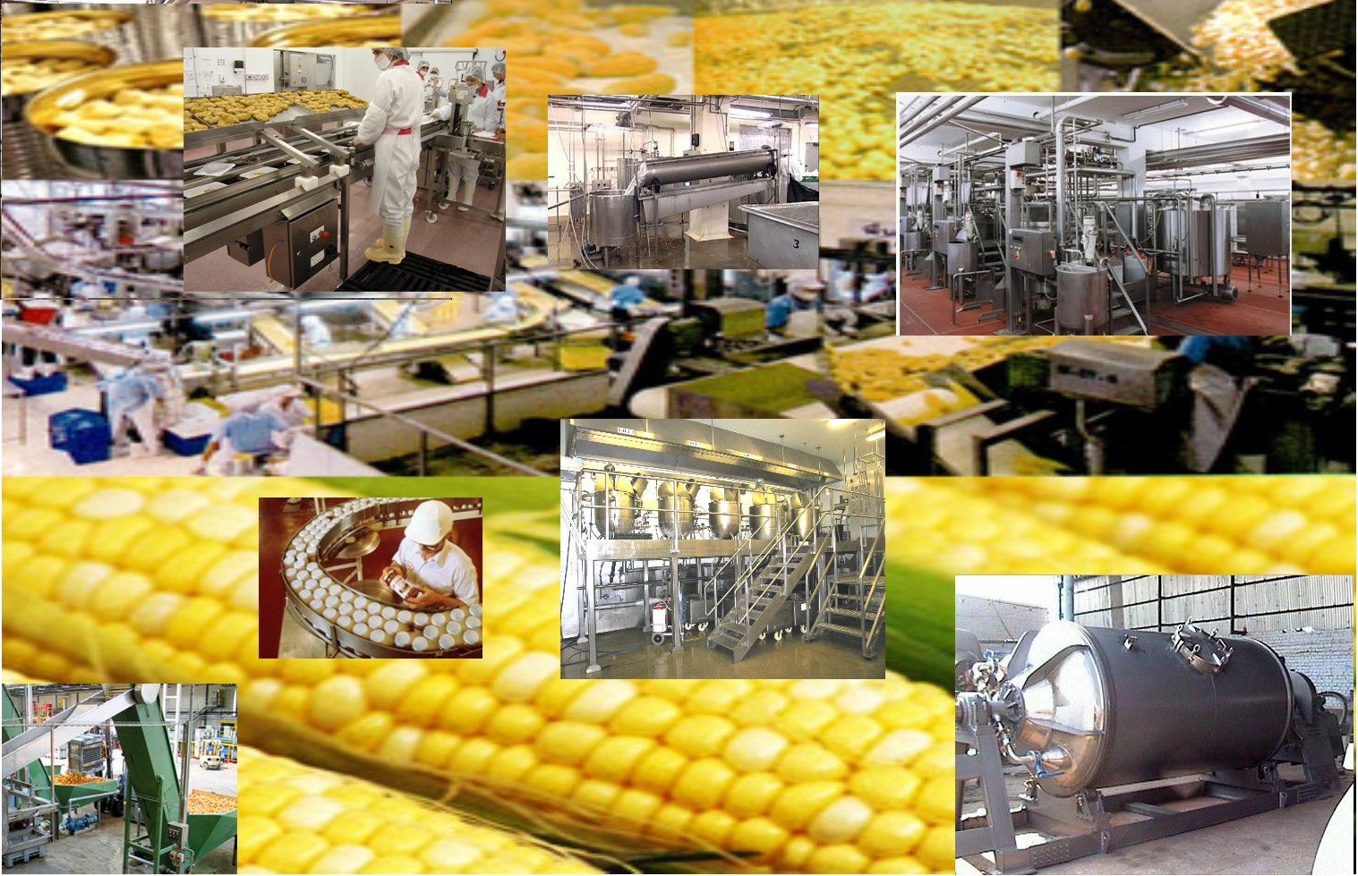
Dr. MCRHRDIAP 87th FOUNDATION COURSE
NATIONAL FOOD PROCESSING POLICY
Presented by-Group No-13

Slide 2
Team Members
Anila Kumari T.
Gajendra Soni
Mahipal Singh
Prasoon Verma
Prerna Gupta
Pruthvi Raj
Sandeep Rana
Shiva Prakash Devaraju
Swagata Mitra
Vaibhav Agarwal

Slide 3
What is Food Processing?
Food Processing
Manufactured Process
Transformation of Physical properties
Commercial Value of the new Product
Other Value-Added Process
Significant Value Addition

Slide 4
Why Food Processing Policy?
Sr No | Crop | Cumulative Wastage (%)
1. | Cereals | 3.9 - 6.0 %
2. | Pulses | 4.3 – 6.1 %
3. | Oil Seeds | 6.0 %
4. | Fruits & Vegetables | 5.8 – 18.0 %
5. | Milk | 0.8 %
6. | Fisheries | 2.9 %
7. | Meat | 2.3 %
8. | Poultry | 3.7 %
Percentage of Losses Estimated for Major Produces
Source: A Study by CIPHET, 2010

Slide 5
Why Food Processing Policy?
Field Losses
(Pest, Diseases, Rodents etc))
Rich Countries – High losses at a later stage in the food chain
Developing Countries – Relatively high losses in the initial parts of the value chain
Producer
Pre-Processing
(e.g. inefficient harvesting, drying)
Transport
(e.g. spillage, leakage)
Storage
(e.g. technical deficiencies)
Processing & Packaging
(e.g. excessive peeling, washing)
Marketing
(e.g. spoilage, rotting in stores)
Consumer
Wastage by Consumer
(e.g. overeating, food wastage)
Field
Fork

Slide 6
Why Food Processing Policy?
Multiplicity of Laws and Regulatory Authorities
Lack of participation of Cooperative Institutions, PRIs and NGOs
Adherence to Quality and SPS Measures under WTO
Little Value Addition in Food Processing Industry–7%
75% of the Sector comprises of Small Scale & Unorganized sector

Slide 7
Salient Features of National Food Processing Policy
Creating Enabling Environment
Infrastructural Development
Backward Linkage
Special Provision
Forward Linkage

Slide 8
Creating Enabling Environment
Fiscal Initiatives (Rationalization of Tax Structure)
Harmonization & Simplification of Food Laws
Investment Promotion (Foreign and Domestic)
Market Creation for Processed Food

Slide 9
Infrastructural Development
Development of Back-End Infrastructure
Infrastructure to implement Latest Technologies of the sector
Development of Agro Food Parks and Food Processing Training Institutes

Slide 10
Backward Linkage
Linkage between Farmers and Processors
Development of Futures Market
Minimize the Gap between Farm-Gate Price and Final Price

Slide 11
Forward Linkage
Elimination of Intermediaries in the Market
Marketing Network
Development of Marketing Capabilities

Slide 12
Stakeholders
Consumers
Government
Farmers
Stakeholders
Academic & Research Institutions
Cooperatives,NGOs,PRIs
Financial Institutions

Slide 13
Merits of The Policy
Farmers
Better Remuneration
Reduced Risks and Uncertainties
Consumers
Quality products at Lesser Costs
Access to Advanced Technology
Increase in Product Varieties

Slide 14
Merits of The Policy
Infrastructure Development
Pre-processing
Research & Development
Industrial Linkage
Economic Benefits
Inclusive Growth
Transportation & Warehousing
Futures Market
Export Promotion
University Linkage
Post-processsing

Slide 15
Areas of Concern
Transition from Food Crops to Cash
Crops – threatening Food Security
Regulation of Foreign Investment in Food Processing Sector
No Provision for Regulation of Processing Units
Failure to Address the issue of Low Credit Availability
Absence of specific provisions for small & marginal farmers

Slide 16
Implementation Issues
Large Scale Funding Requirements for Infrastructure Development
Reluctance of Farmers to adapt to the new Environment
Strong Chain of Middle-men
Financial Inclusion issues for the Farmers
Synergy between Center & States

Slide 17
Suggestions & Recommendations
Effective Implementation of the Measures suggested in the Policy
Fast & Effective Implementation of GST
Emphasis of 2nd Green Revolution to suit the Food Processing Industry
Incentives for Import of Food-Processing Technologies
Establishment of National Bank (like NABARD) for Food Processing Sector

Slide 18
Conclusion
National Food Processing Policy is an effective step to vitalize & synergize the linkages between Agriculture & Industry. If it is implemented effectively it will surely lead to food security, overall growth and empowerment of the farmers, consumers and the nation as a whole.

Slide 19
Thank You

